Slide 1
TEN SLIDES LOOKING
BACKWARD
TEN SLIDES LOOKING FORWARD
By Jackson Parker

Slide 2
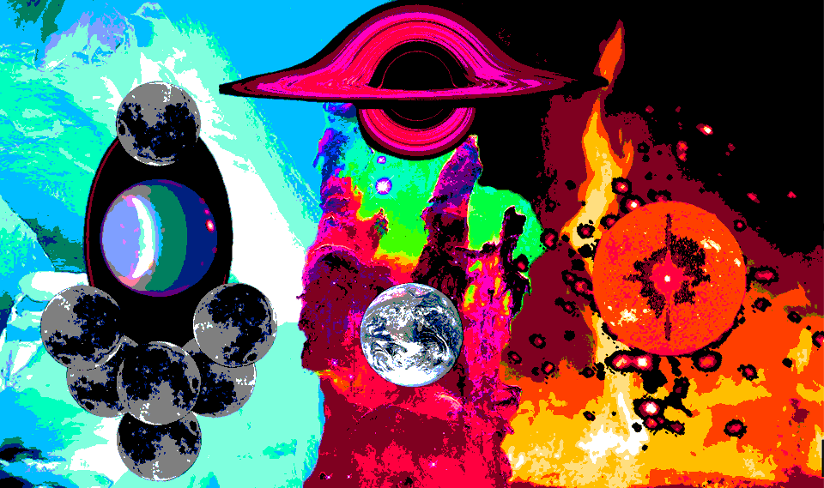
Notes:
In the beginning, the gods descended from the heavens, and created the earth.

Slide 3
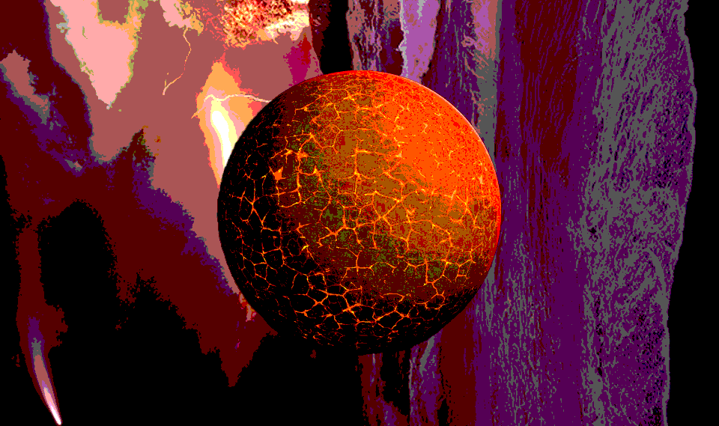
Notes:
It was a barren world. Sterile and lifeless. Shifting only under divine power. And the gods were content. They basked in the earth’s eternal perfection. But there was one amongst them who could not rest.

Slide 4
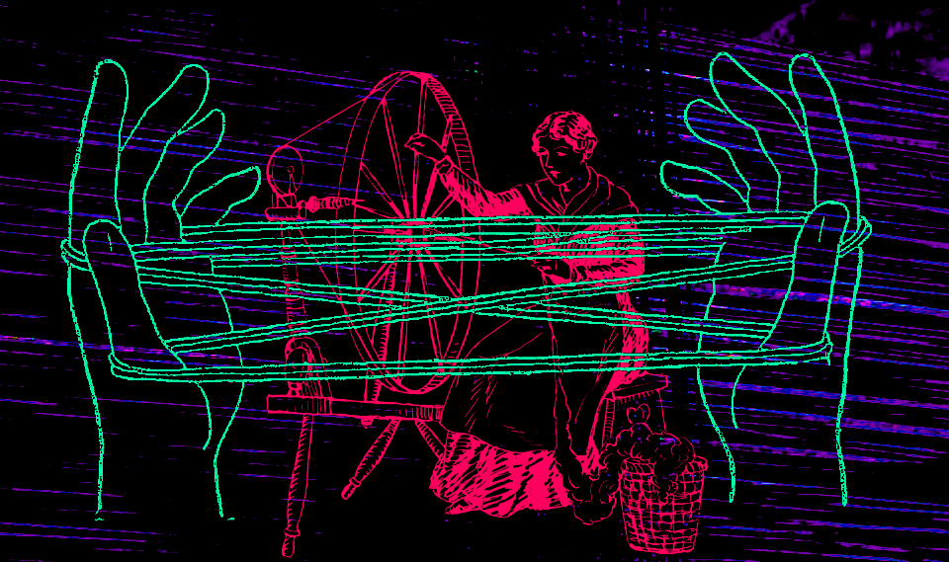
Notes:
The weakest of the gods toiled in a forgotten place. In the darkest corner of the world, it conceived a furtive design. From elements left in the other gods’ wake, it spun a single thread.

Slide 5
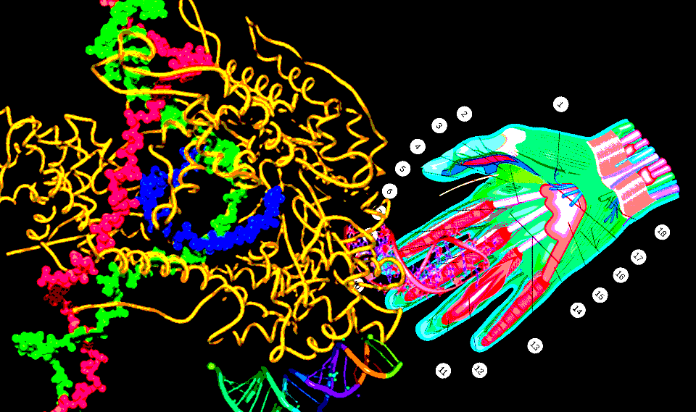
Notes:
And it was no ordinary strand, for once it was twisted together, it continued to spin. And as it spun, it gathered more elements, and it became longer, until it was a tangled mass. This convolution only deepened, and soon the thread grew long enough to catch the attention of the other gods.

Slide 6
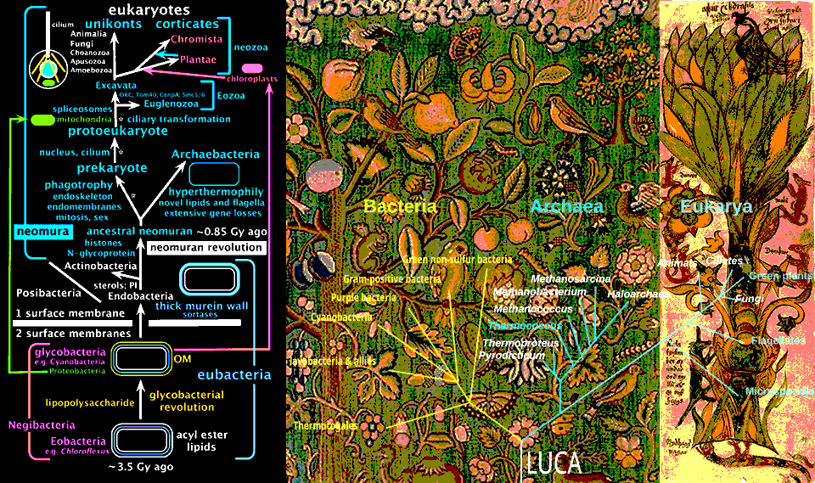
Notes:
Enraged at the existence of such a creation, and in fear that it would consume their perfect world entirely, the other gods placed a curse upon the strand. Their blades cleaved it apart, but it did not die. It only branched in twain. And as it grew, the curse continued to cut, and the thread continued to branch.

Slide 7
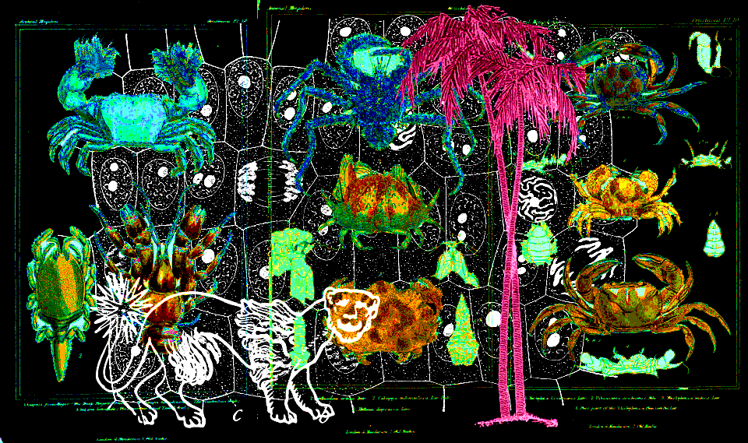
Notes:
Soon, the tangled masses of thread coalesced into distinct forms, and the fury of heaven burned brighter. Curse upon curse fell down to earth. Fire and ice and storms and falling mountains buffeted the planet, but the thread forms were resilient. They continued to branch.

Slide 8
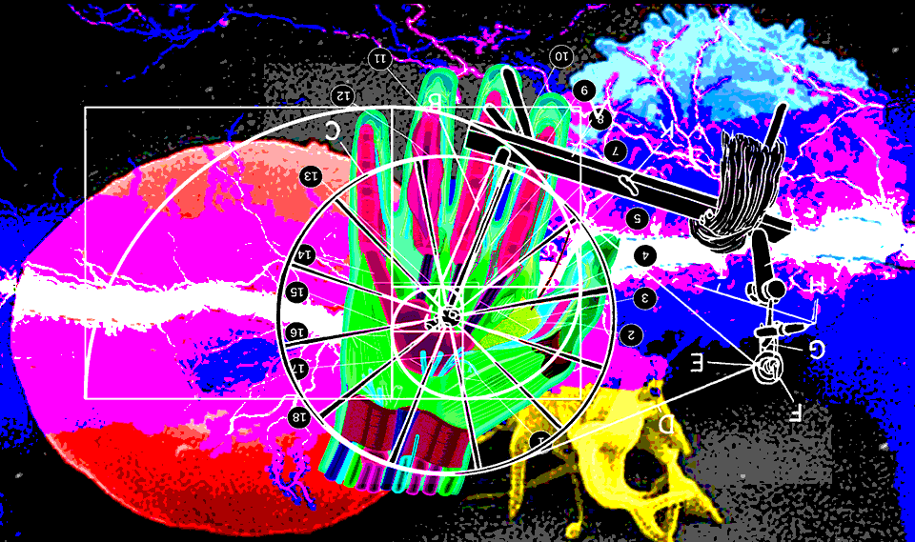
Notes:
Finally, the gods captured the lesser being that created the strand, and under pain of torture, it revealed the path to annihilating its creations: The key was ichor, the blood of gods. They were to pour it out over the earth, and after contact with the substance, the strand would be destroyed. Having no other solution, the gods did as it instructed.

Slide 9
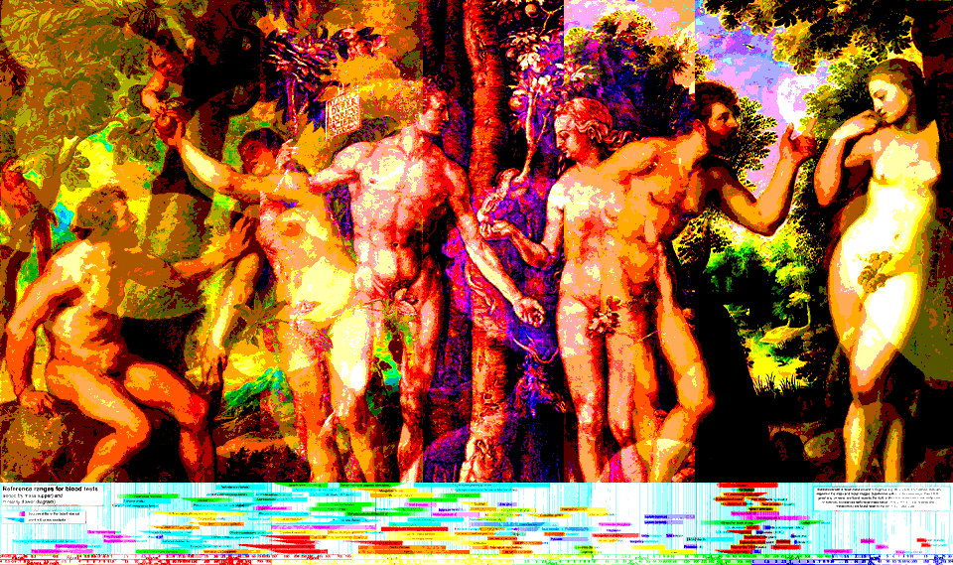
Notes:
But their blood did not destroy the strand. Any thread form that touched the ichor gained fragments of divine knowledge. One form took to coveting this wisdom. It collected ichor wherever it could be found, and from knowledge it wove entire worlds within itself. This form came to be known as the human.

Slide 10
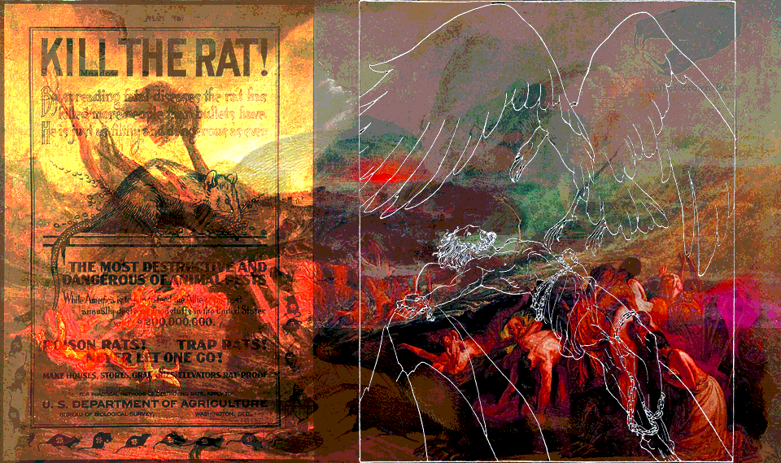
Notes:
The gods were more disgusted by this creature than any other that had polluted the earth. It made a mockery of their power by mimicking creation, but the thread’s creator insisted that such beings were key to the purification of the planet. The gods did not believe it. They imprisoned the creator deep within the earth.

Slide 11
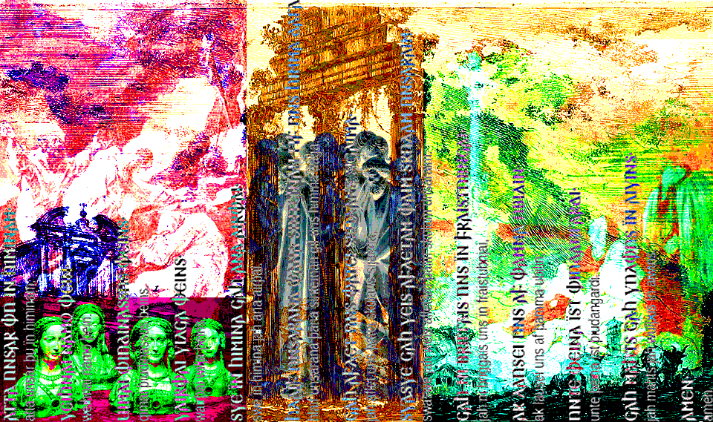
Notes:
Despite their best attempts to hide from the verminous humans, the gods could not entirely avoid attention. The humans became aware of their divine precursors through brief encounters, and took to worshipping them, in hopes that the gods would offer succor. Whether it be for wealth, love, or mercy, each human begged.

Slide 12
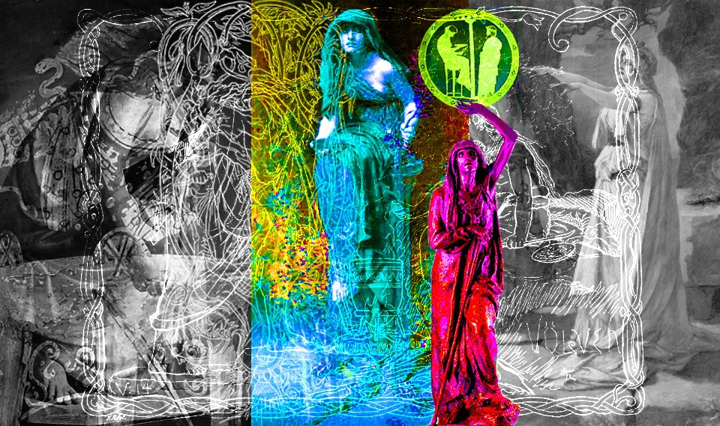
Notes:
And the rest… Well, you can open a history textbook to find that. You come to me because you are looking forward, no? You wonder what fate the creator had in store for you and your planet? Worry not. I will show you what the future holds.

Slide 13
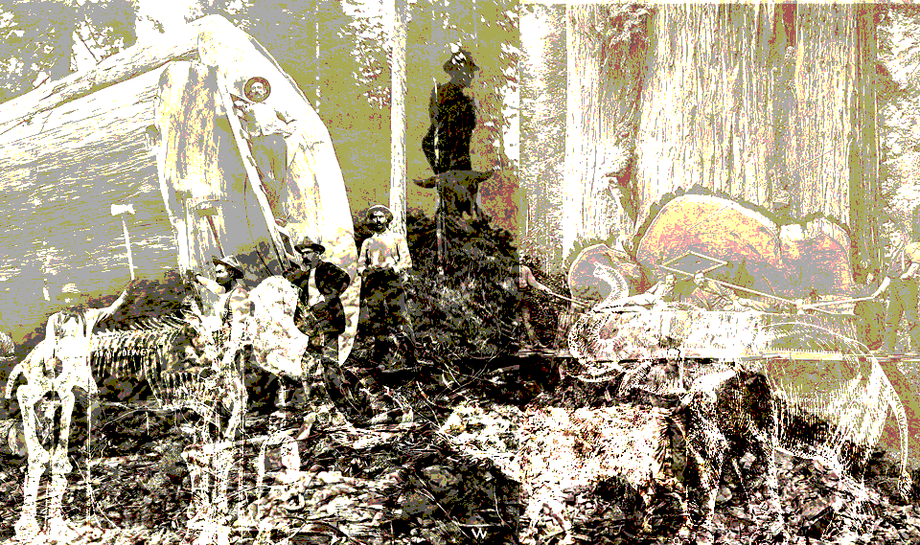
The
First
Plague:
Death
Of The
Giants
Notes:
The largest and oldest creatures will be wiped out by humanity. Your kind will hound them to the ends of the earth, until their extinction.

Slide 14
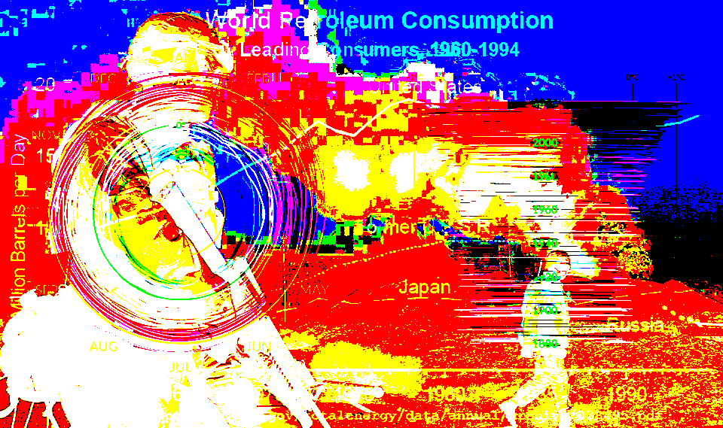
The Second Plague:
Climate Crisis
Notes:
Your kind will burn the dead until smoke blankets the earth. Temperatures will fluctuate. Ice will melt. The sea will rise.

Slide 15
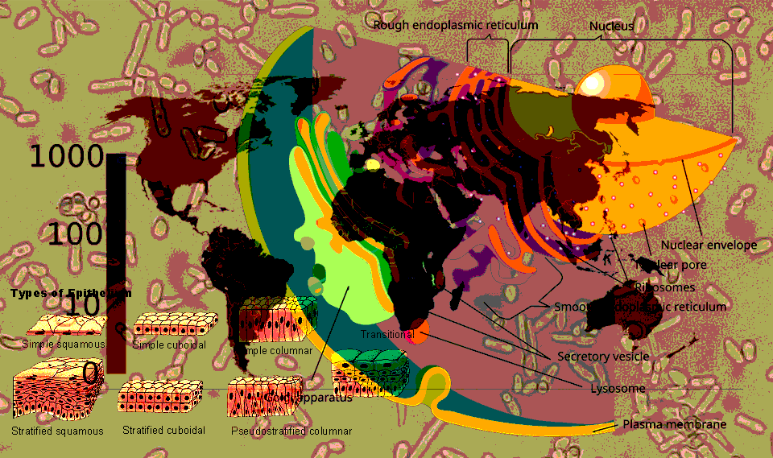
The Third Plague:
Universal
Pestilence
Notes:
Your kind will create microbial life from pure elements. It will evade all immune systems as they have evolved upon the earth. Nothing will resist this new disease.

Slide 16
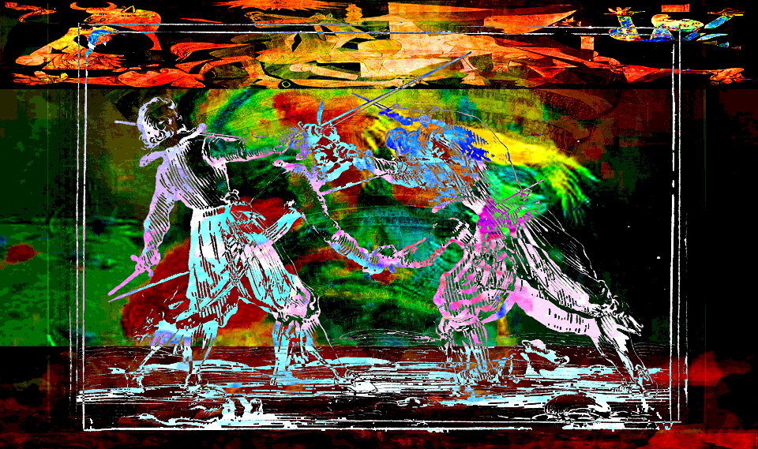
The Fourth Plague:
Breaking of Kinship
Notes:
Your kind will turn against itself. Society as you know it will dissolve. No human will spare another’s life.

Slide 17
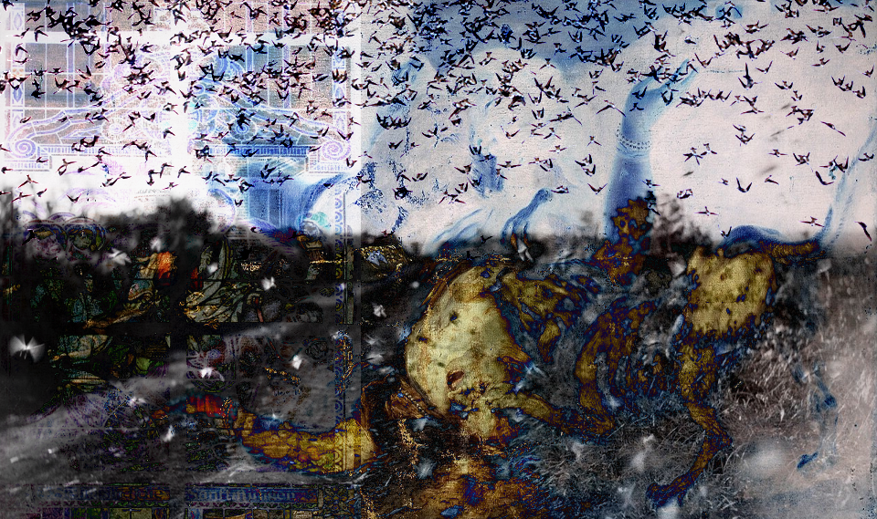
The Fifth Plague:
Vengeance
Notes:
Other forms will turn against your kind. Each plant and animal will devote itself to vengeance against the destroyers of the earth.

Slide 18
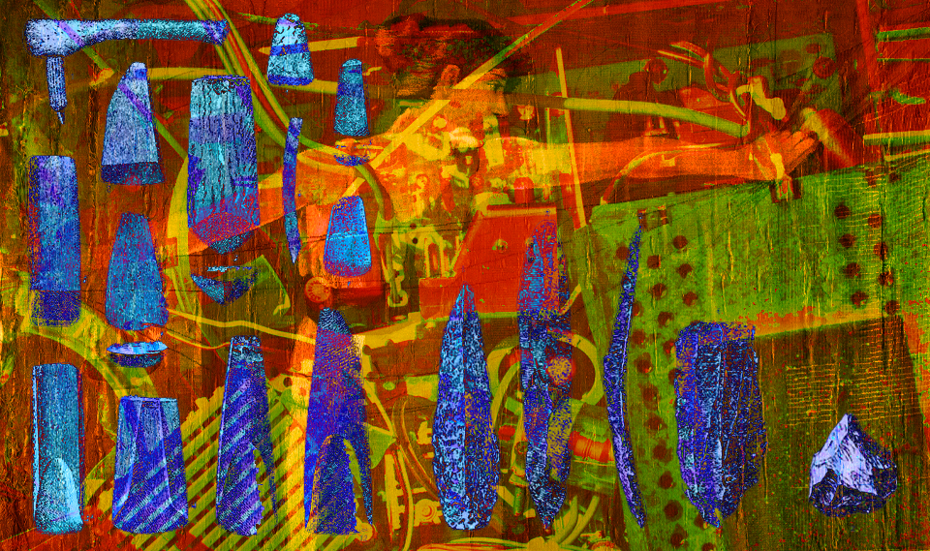
The Sixth Plague:
Return
To
Nature
Notes:
All of your tools will fail. Everything from the greatest computer to the most humble basket will be unraveled. Your kind will struggle with tooth and nail, as they should have from the beginning.

Slide 19
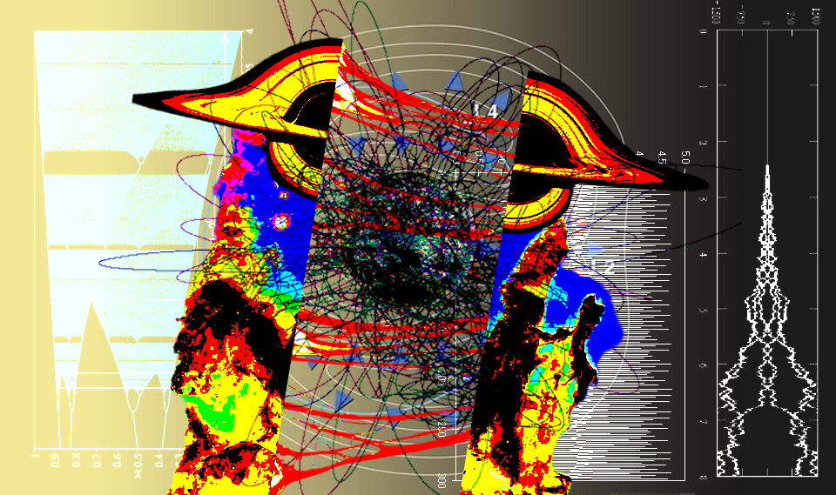
The
Seventh
Plague:
Death
Of The
Gods
Notes:
Undeterred by all that came before, Your kind will encroach upon the last sanctuaries of the gods, and slay them with bare and bloodied hands. The bonds of reality will be sundered. The world will shatter.

Slide 20

The End?
Notes:
All remaining humans will be adrift in an endless, lawless, formless, plane. They will exist in this reality for so long, that they forget what came before, and remember what comes after. They will master this new reality, and shape it to their will.

Slide 21
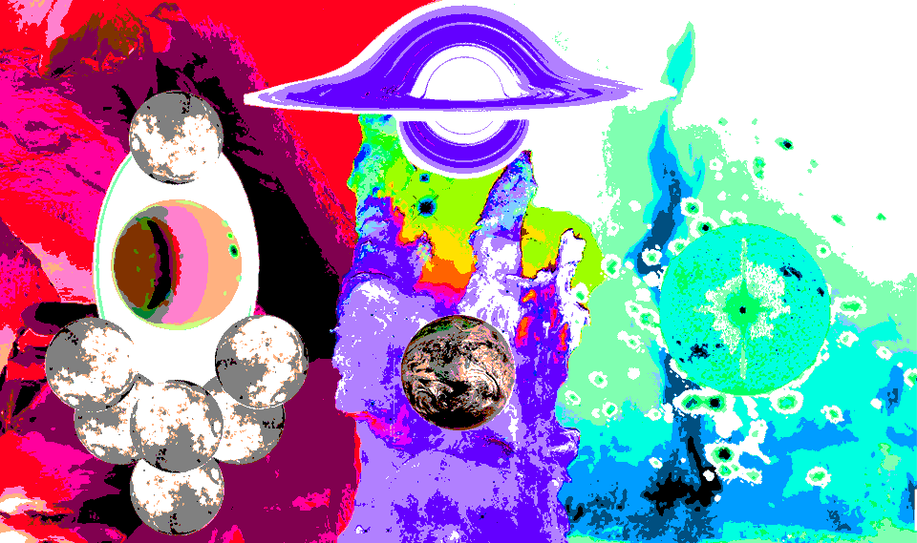
The
Beginning
Notes:
The remaining humans, in wildly altered form, will descend from the heavens and build a world. A sterile and lifeless place. They will be content. They will bask in their world’s eternal perfection. But there will be one amongst them who cannot rest…

